Slide 1
MCL + Alternative Resources
PPoPP ‘21
Ryan Friese, Roberto Gioiosa, Alok Kamatar

Slide 2
Tutorial Outline
Some prep work first
NVDLA background
Actual hardware + Emulation
Then the fun stuff – performing inference on NVDLA emulators
pulling the mcl ppopp21 tutorial docker (docker pull minoscomputing/ppopp21)
If you haven’t done so already go ahead a download now
Stepping through an example application
Launching NVDLA emulated devices
Launching MCL scheduler
Executing our test app!

Slide 3
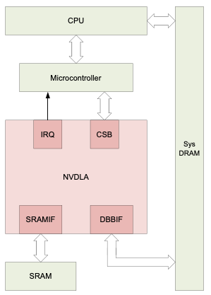
NVDLA – Nvidia Deep Learning Accelerator
Accelerates compute effort of deep learning inference
4 main groups
Convolutions
Activations
Pooling
Normalization
Share a few similar Characteristics
Regular/Predictable memory access
Readily parallelizable
Goal: standardized, open architecture for deep learning inference
Scalable
Configurable (w.r.t. overall accelerator)

Slide 4
Nvidia Jetson AGX Xavier
Nvidia developed DLA
Headed implementation
Controller coprocessor closed source
GPU | 512-core Volta GPU with Tensor Cores
CPU | 8-core ARM v8.2 64-bit CPU, 8MB L2 + 4MB L3
Memory | 32GB 256-Bit LPDDR4x | 137GB/s
Storage | 32GB eMMC 5.1
DL Accelerator | (2x) NVDLA Engines

Slide 5
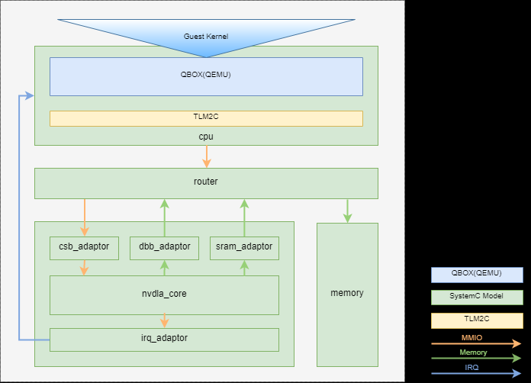
Nvidia NVDLA Virtual Platform
The Open Source offering provided by Nvidia (http://nvdla.org/vp.html)
QBOX: System-C + Qemu based emulation (what we will be using)
Register accurate emulation
(although not Virtual, the same open source hardware + software works with FPGAs)
From our point of view we interact with the emulated devices as if they are network attached accelerators
We run a lightweight server process on the guest server
You could conceivably run a full-fledged OS on the guest and interact with as a local accelerator

Slide 6
DLA Stack
Xavier
Other DL
frameworks
NVDLA VP
TRT Binary Image
Nvdla Binary
NVDLA Open Source Compiler
NVDLA Open Source Runtime
Manual memory management, resource selection, kernel launching, etc
MCL
Manual memory management, resource selection, kernel launching, etc
Lightweight Server
POCL
network
NVDLA
NVDLA
Emulator

Slide 7
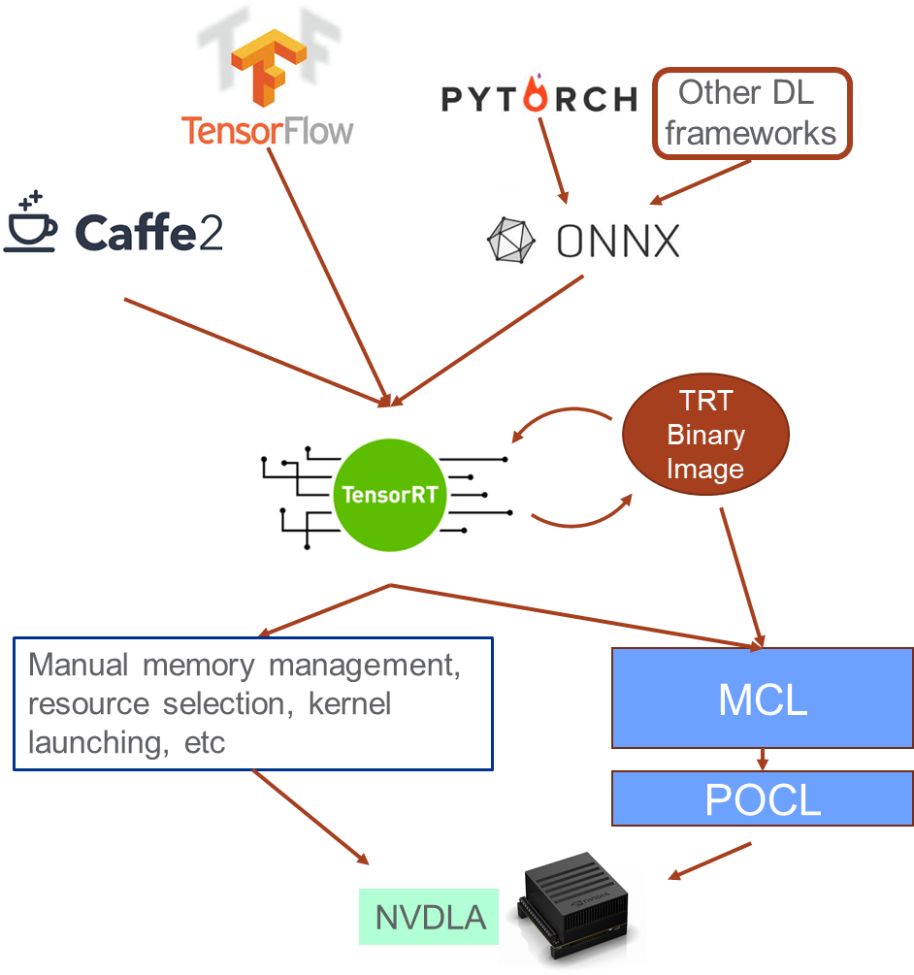
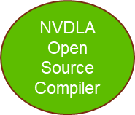
Model Construction and Training
Models implemented using high level ML API’s
Training performed offline
Potentially on more powerful systems
Networks + Weights serialized
ONNX
Caffe
UFF

Slide 8
Inference Engine Creation
Ingest network definition & weights
Or define network manually using TensorRT/OpenSource Runtime
Specify parameters (some dependent on network definition)
Devices (Which DLA Core, allow GPU fallback)
Batch size
FP mode
Serialize inference engine
NVDLA binary executable
On the Xavier use `trtexec`
On the virtual platform use `nvdla_compiler`

Slide 9
Model Execution (Inference) on Xavier
Deserialize binary into InferenceEngine
Construct ExecutionContext
Allocate and load input/output buffers
Unified memory on the Xavier
Create and initialize cudaStream (work queue)
Enqueue inference task
Wait on task completion
Cleanup
All implemented using the TensorRT C++ API
Also requires some additional bookkeeping and ancillary data structures

Slide 10
Model Execution (Inference) on Virtual Platform
Create Nvdla Runtime
Load model & Initiate EMU
This is roughly the equivalent of a ExecutionContext
Only one model can be loaded at a time (per NVDLA “Core”)
Allocate and load input/output buffers
A call to allocate a separate call to bind to current model
Submit inference task
Synchronous operation
cleanup
All implemented using the NVDLA OpenSource C++ API
There are multiple layers of API available to interact with the devices, we currently are using the highest

Slide 11
MCL – NVDLA integration
Recall: MCL is built on top of OpenCL
Recall: Tasks are OpenCL kernels (source code) and associated inputs/outputs
Compiled/executed depending on the device a task runs on
Devices managed by the MCL Scheduler
NVDLA does not have an OpenCL implementation nor does it compile directly from source
For integration we have developed a custom POCL¹ device for the NVDLA
Currently, ingests preconstructed DLA binary
Looking into direct construction from an ML deployment model (e.g. ONNX)
Would eliminate user needing to run “trtexec” or “nvdla_compiler” or implement a custom serializer
¹http://portablecl.org/

Slide 12
NVDLA POCL Driver
POCL – Portable Compute Language
Open source implementation of OpenCL standard
Provides the connection between MCL and NVDLA
Xaiver – calls directly into TensorRT
Virtual Platform – connects to our lightweight server running in the Qemu image
Device discovery and initialization
Buffer/memory management
Launches and reports finished execution of tasks
Implemented using the OpenCL “builtin_kernel” interface
Specifies that the device doesn’t run arbitrary OpenCL code

Slide 13
Time to test it out!
Hopefully by now your docker image has finished downloading
Recall: “docker pull minoscomputing/ppopp21”
Goal: Take a pretrained mnist (digit recognition) model and use it to performance inference on an (emulated) NVDLA
We will perform the following steps:
Instantiate NVDLA Qemu devices
Compile mnist caffe model into an nvdla binary
Launch MCL scheduler process with POCL envargs to enable NVDLA’s
Perform inference using an example MCL application

Slide 14
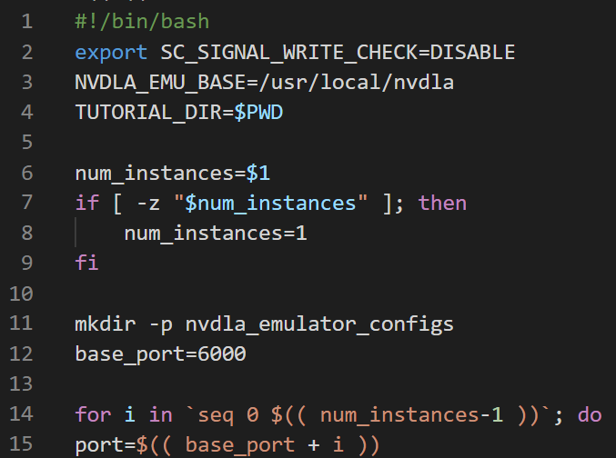
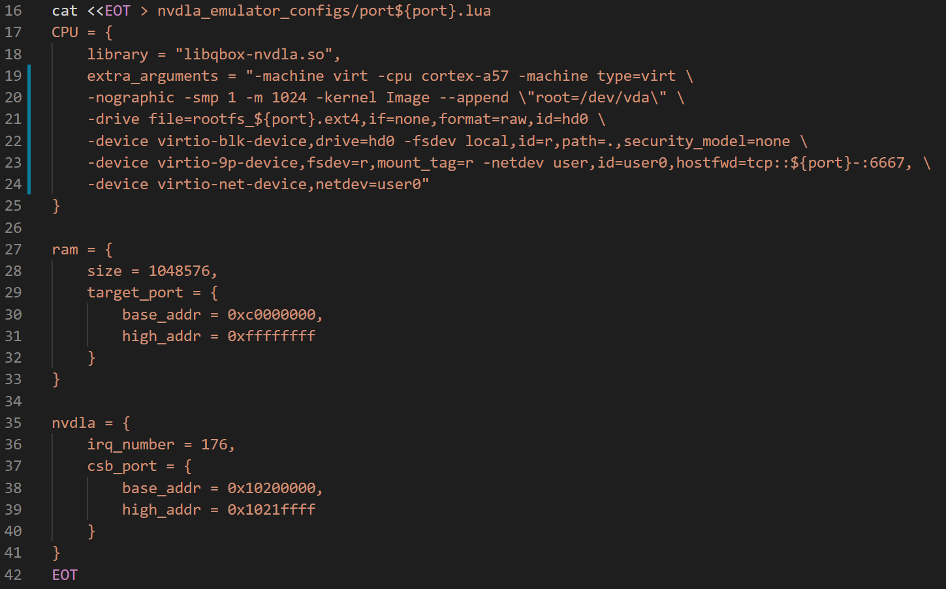
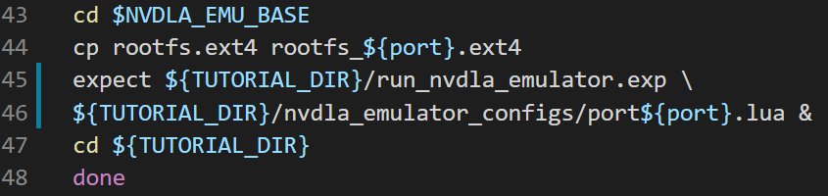
Instantiating NVDLA Qemu Devices – Host Side
host:~# docker run –name ppopp21 –it minoscomputing/ppopp21 /bin/bash
root@container:/ppopp21# cd nvdla/
We can create multiple emulated NVDLAS!
Each instance forwards a unique host port
root@container:/ppopp21/nvdla#./start_nvdla_emulator.sh 2
NVDLA Qemu configuration
Each instance creates a copy of the virtual hard drive

Slide 15
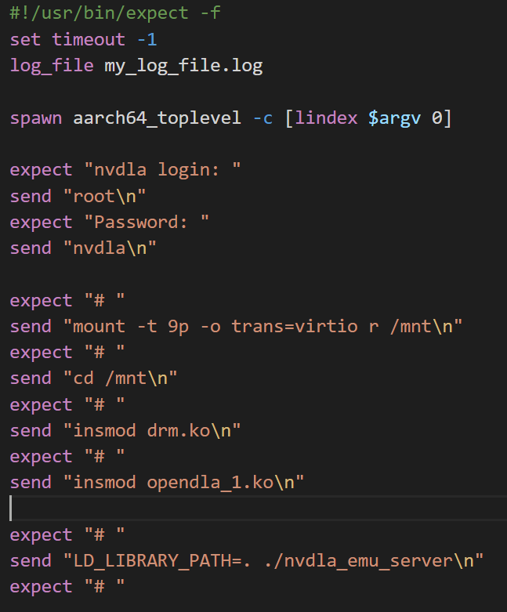
Instantiating NVDLA Qemu Devices – Guest side
host:~# docker run –name ppopp21 –it minoscomputing/ppopp21 /bin/bash
root@container:/ppopp21# cd nvdla/
root@container:/ppopp21/nvdla#./start_nvdla_emulator.sh 2
Launch the Qemu instance
“expect” is a program that allows us to talk to other interactive application via a script
Mount from the host the directory where this image was launched
Insert the NVDLA device driver module into the driver
Launch lightweight server

Slide 16
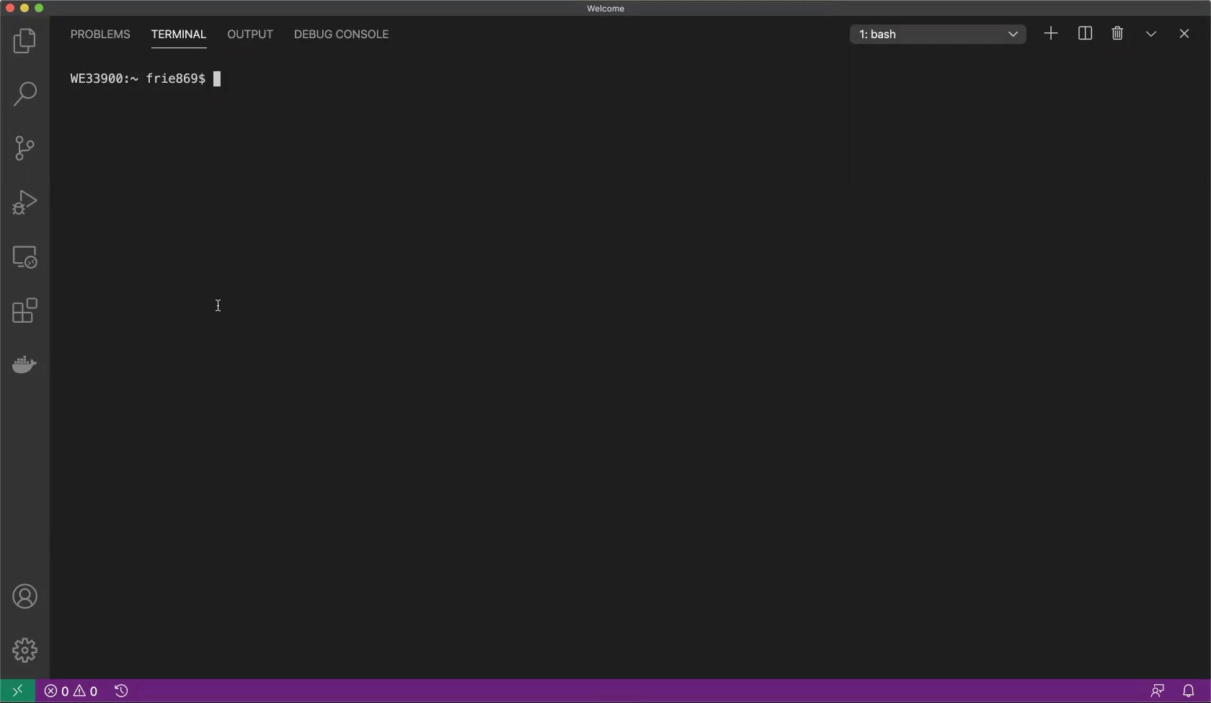
Instantiating NVDLA Qemu Devices
host:~# docker run –name ppopp21 \
-it minoscomputing/ppopp21 /bin/bash
root@container:/ppopp21# cd nvdla/
root@container:/ppopp21/nvdla# \
./start_nvdla_emulator.sh 2

Slide 17
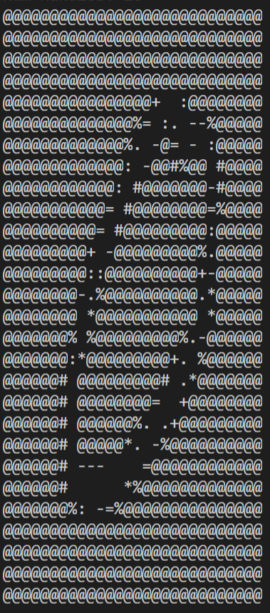
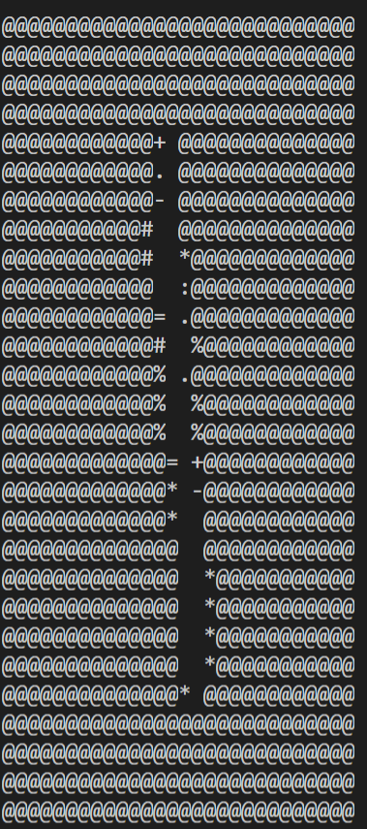
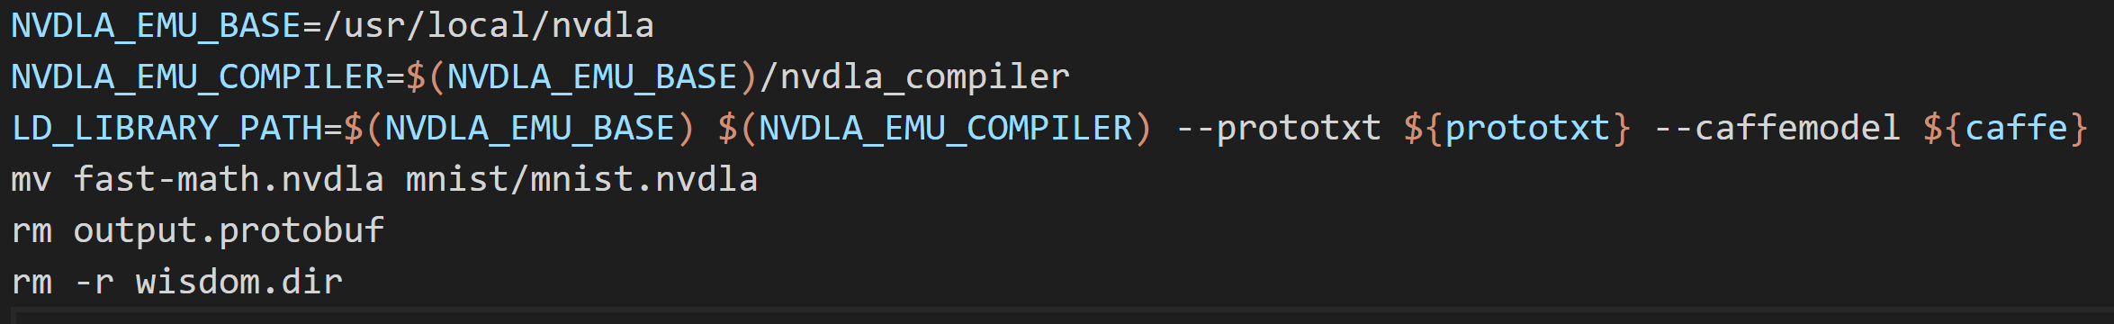
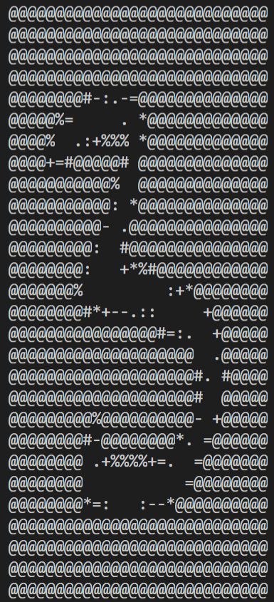
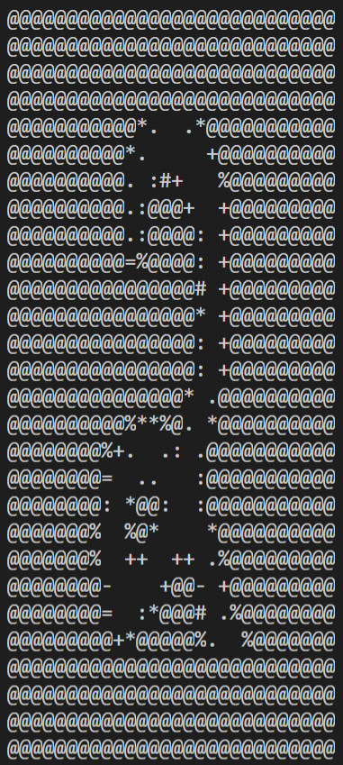
Compiling MNIST model to NVDLA format
# we want our qemu images running so open a new terminal
host:~/#docker exec -it ppopp21 /bin/bash
root@container:/ppopp21# cd nvdla/
root@container:/ppopp21/nvdla# make caffe=mnist/mnist.caffemodel \ prototxt=mnist/mnist.prototxt nvdla_emu_bin
Nvidia Open Source nvdla compiler
(comes prebuilt on the virtual platform)
Rename from default
Rename from default
The process on the Xavier is very similar but uses a different compiler
In theory NVDLA binaries should be compatible across different implementations assuming the layers with the network are present in the accelerator
We have not (yet) been able to use the same binary on the Xavier and the emulated NVDLA

Slide 18
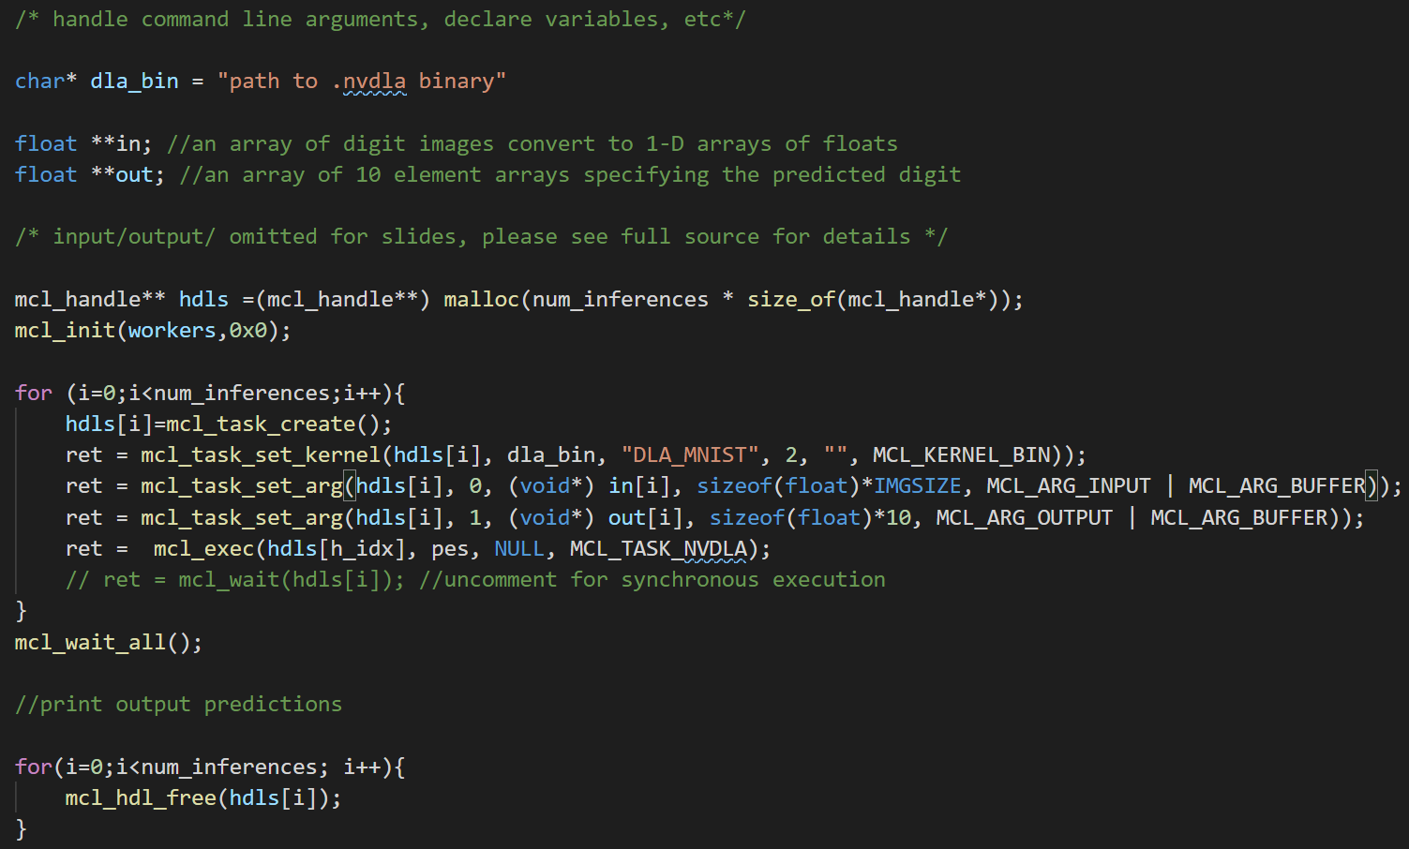
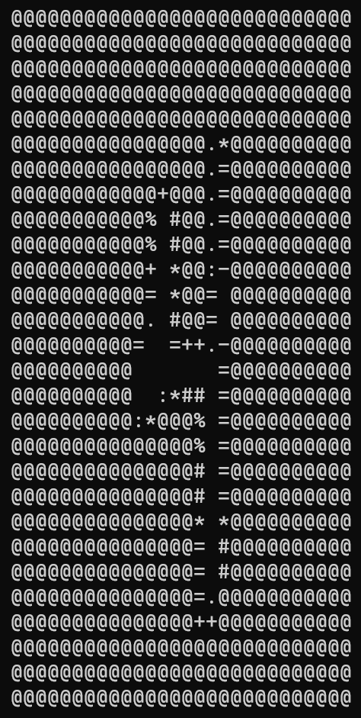
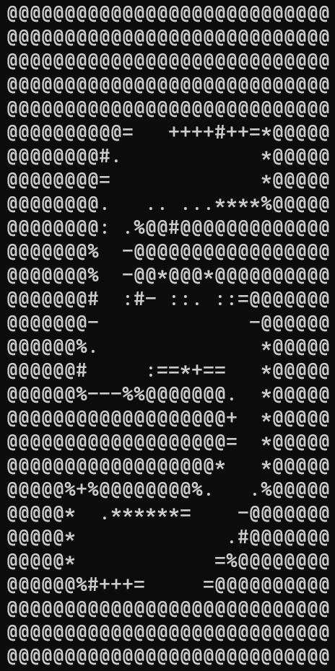
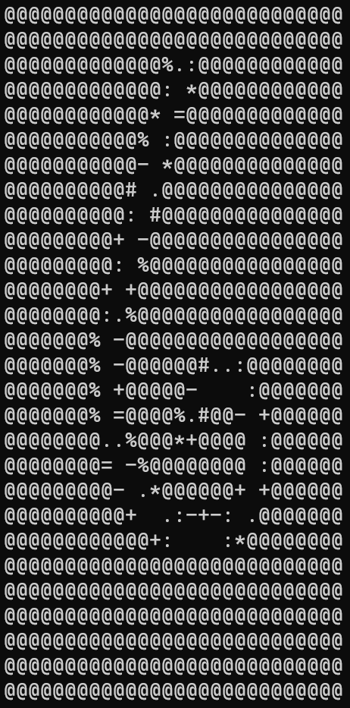
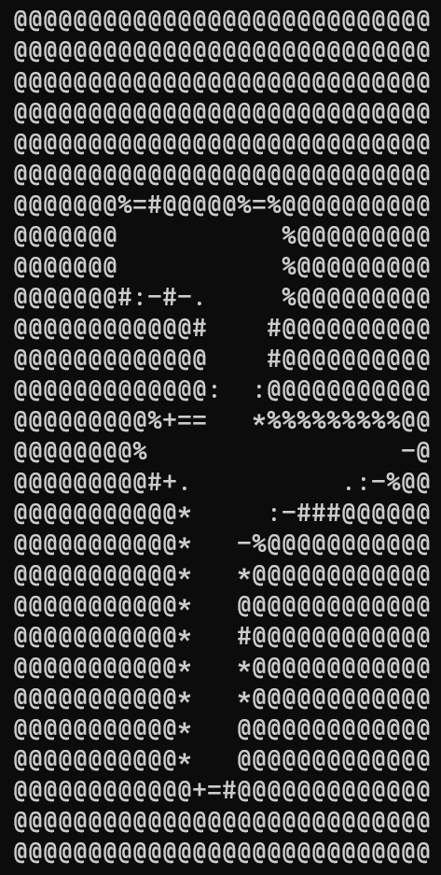
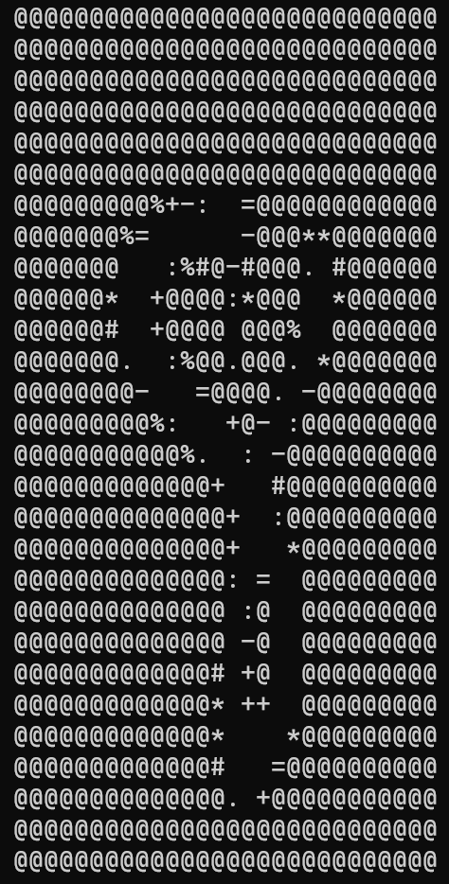
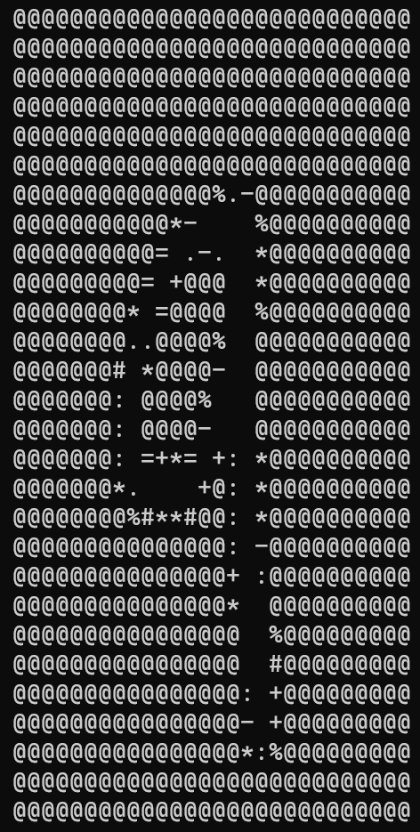
Stripped Down MCL Application (MNIST)
We want to perform inference to predict what digit is present within an image
The only thing we need to (potentially) change is the nvdla binary path to run on hardware vs emulated NVDLAs
The docker container contains a full implementation of this application
Currently compiled offline (previous slide)
Tell MCL this is a kernel binary
Pass DLA binary path
when declaring kernel
Force execution on an NVDLA
root@container:/ppopp21/nvdla# make nvdla_test

Slide 19
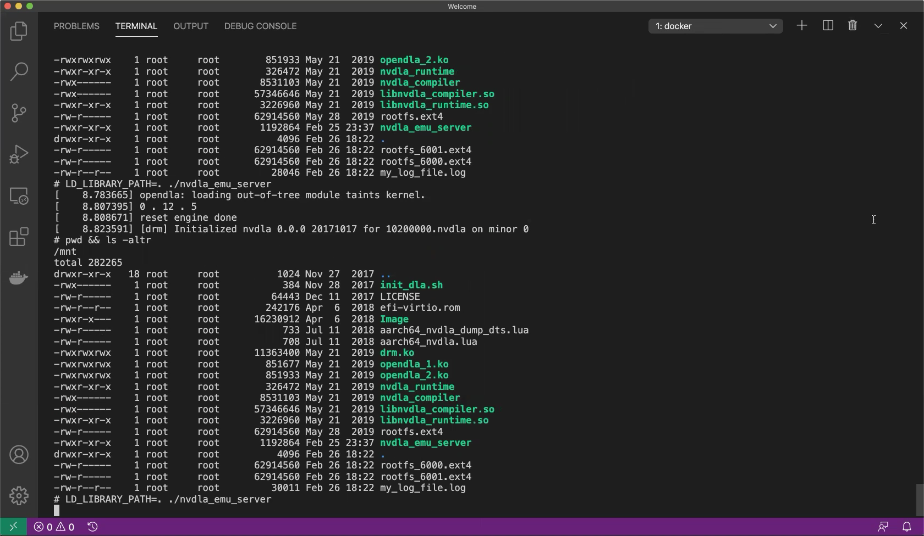
Compiling NVDLA Binary and MCL Executable
# we want our qemu images running so open a new terminal
host:~/# docker exec -it ppopp21 /bin/bash
root@container:/ppopp21# cd nvdla/
root@container:/ppopp21/nvdla# make caffe=mnist/mnist.caffemodel prototxt=mnist/mnist.prototxt nvdla_emu_bin
root@container:/ppopp21/nvdla# make nvdla_test

Slide 20
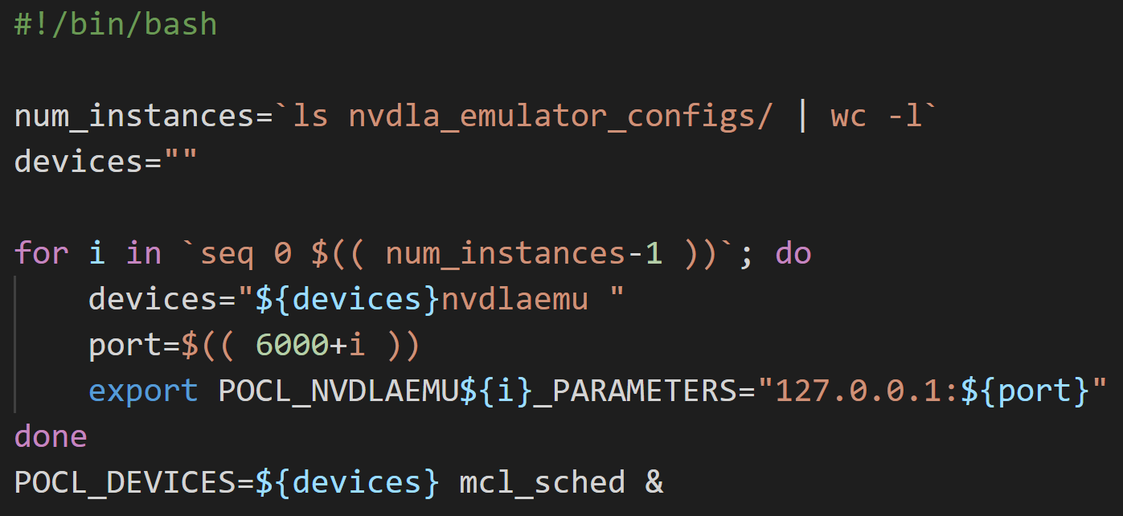
Launching the MCL Scheduler
Generally, just need to call
Because we are using POCL + multiple emulated NVDLA we provide a wrapper script to help set some environment variables
mcl_sched
root@container:/ppopp21/nvdla#./launch_mcl_sched.sh
POCL device name
List of devices for POCL to use

Slide 21
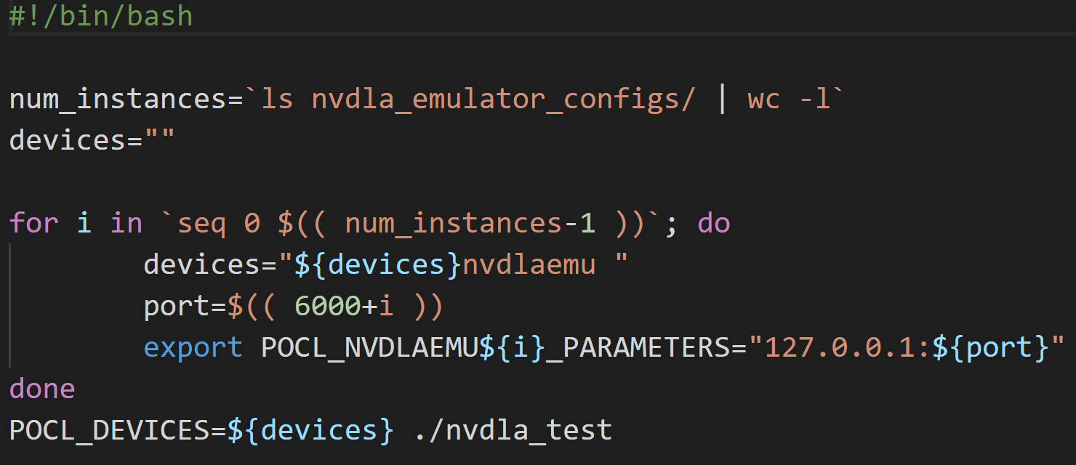
Running our MCL MNIST Inference application
Similar to the MCL scheduler, we must set the same POCL environment variables, so we again wrap the nvdla_test binary in a script
root@container:/ppopp21/nvdla#./run_nvdla_test.sh

Slide 22
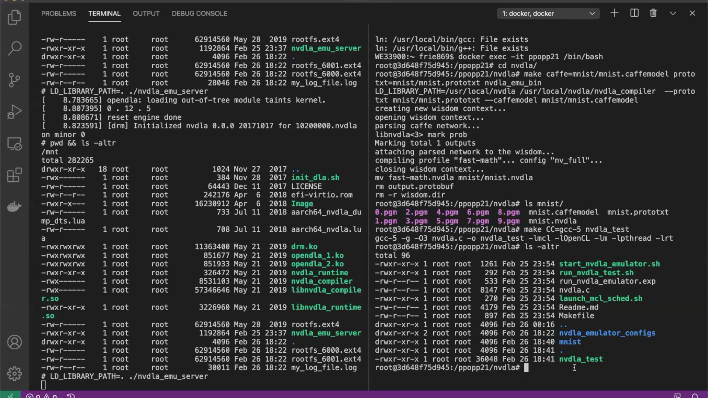
Lets See what Happens!
root@container:/ppopp21/nvdla#./launch_mcl_sched.sh
root@container:/ppopp21/nvdla#./run_nvdla_test.sh

Slide 23
TL;DR (TL;DW)
host:~# docker run –name ppopp21 –it minoscomputing/ppopp21 /bin/bash
root@container:/ppopp21# cd nvdla/
Start Emulated NVDLAs
root@container:/ppopp21/nvdla#./start_nvdla_emulator.sh 2
# we want our qemu images running so open a new terminal
host:~/# docker exec -it ppopp21 /bin/bash
root@container:/ppopp21# cd nvdla/
root@container:/ppopp21/nvdla# make caffe=mnist/mnist.caffemodel prototxt=mnist/mnist.prototxt nvdla_emu_bin
Compile NVDLA & MCL Binaries
root@container:/ppopp21/nvdla# make nvdla_test
root@container:/ppopp21/nvdla#./launch_mcl_sched.sh
Launch MCL Scheduler Execute application
root@container:/ppopp21/nvdla#./run_nvdla_test.sh

Slide 24
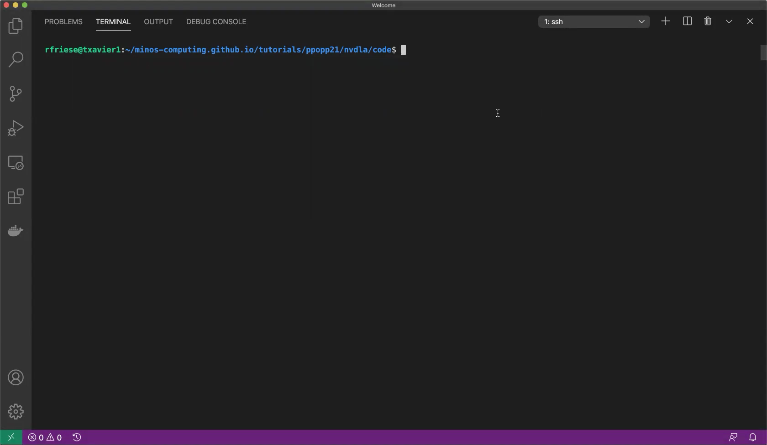
How about on some real Hardware!?
rfriese@xavier:/ppopp21/nvdla# make caffe=mnist/mnist.caffemodel prototxt=mnist/mnist.prototxt nvdla_xavier_bin
rfriese@xavier:/ppopp21/nvdla# make nvdla_test
rfriese@xavier:/ppopp21/nvdla# \
POCL_DEVICES=“nvdla” mcl_sched &
rfriese@xavier:/ppopp21/nvdla# \
POCL_DEVICES=“nvdla” ./nvdla_test

